Slide 1

Facial Emotion Recognition Using Machine Learning
Emotion recognition is a powerful tool for mental health, human-computer interaction, and more. This presentation will explore our innovative project to build a robust emotion classification system using advanced machine learning techniques.

Slide 2
The Importance of Emotion Recognition
Mental Health Applications
Human-Computer Interaction
Diverse Use Cases
Emotion recognition can aid in the assessment and monitoring of mental health conditions, enabling more personalized and effective treatment.
By understanding user emotions, AI systems can provide more natural and empathetic responses, enhancing the overall user experience.
Emotion recognition has applications in fields like customer service, game design, and security, where understanding human emotional states is crucial.

Slide 3

Project Purpose: Emotion Classification
1
Develop a Robust Emotion Recognition System
2
Enhance Real-World Applications
The system will be designed to integrate seamlessly into various applications, improving user experiences and enabling more personalized interactions.
Our goal is to build an AI-powered facial emotion recognition model that can accurately classify a wide range of human emotions.
3
Contribute to Advancements in AI
By tackling the challenge of emotion recognition, we aim to advance the field of machine learning and push the boundaries of what's possible with AI.

Slide 4

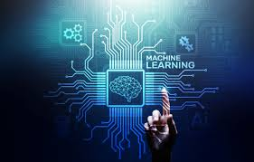

Machine Learning Approach
Data Collection
Model Architecture
Collected data provided in the FER 2013
Challenge of Kaggle. As the dataset being
Niche and not much provided in a certain
Collected format. The future dataset
Would have to be cultivated from scratch
Our team will explore various deep learning architectures, such as convolutional neural networks (CNNs), to optimize emotion classification performance.
Model Training
Evaluation
We will implement state-of-the-art training techniques, including data augmentation and transfer learning, to ensure the model's robustness and generalization.
Rigorous testing and evaluation will be conducted to measure the model's accuracy, precision, recall, and overall effectiveness in real-world scenarios.

Slide 5

Data Collection and Preprocessing
Dataset Acquisition
We will gather a comprehensive dataset(in future) of facial images labeled with corresponding emotions, ensuring diversity in subjects, ethnicities, and lighting conditions.
Quality Assurance
Rigorous data validation and cleaning will be performed to ensure the dataset's reliability and minimize any biases or inconsistencies.
1
2
3
Data Preprocessing
The dataset will undergo extensive preprocessing, including image normalization, facial landmark detection, and data augmentation to enhance the model's performance.

Slide 6




Model Architecture and Training
Convolutional Neural Network/Random Forest Classifier
1
At the core of our emotion classification system is a state-of-the-art CNN architecture, designed to effectively extract visual features from facial images. We can also use a random forest ml model however it sacrifices some vital accuracy
Transfer Learning
2
We will leverage pre-trained models and fine-tune them on our dataset to accelerate the training process and improve the model's performance.
Data Augmentation
3
To enhance the model's robustness and generalization, we will apply various data augmentation techniques, such as rotation, scaling, and color jittering.
Optimization Techniques
4
Advanced optimization algorithms and regularization methods will be employed to ensure the model's convergence and prevent overfitting.

Slide 7
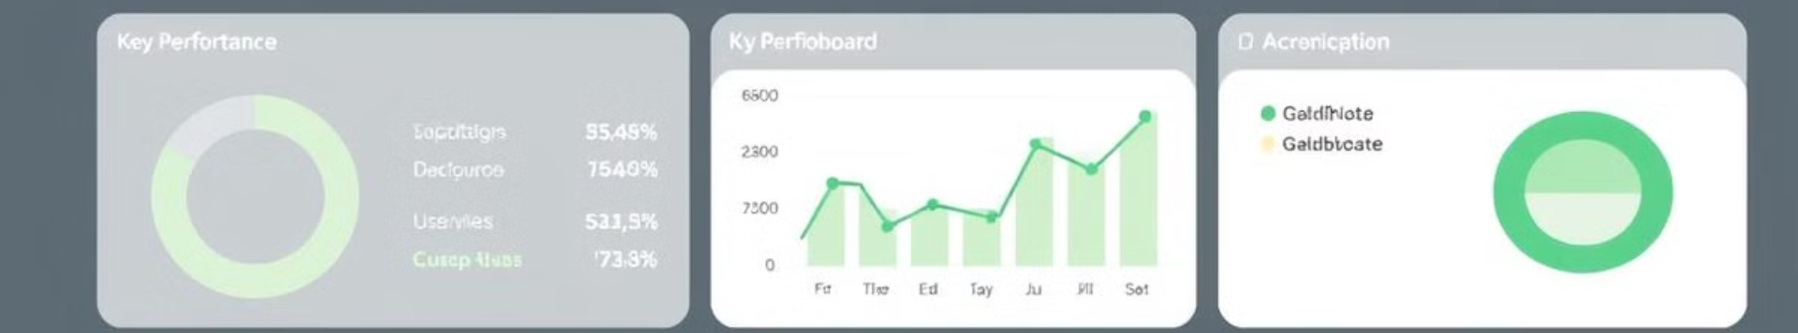




Evaluation and Performance Metrics
Accuracy
Precision
Recall
F1-Score
The model's ability to correctly classify emotions, measured by the percentage of accurate predictions.
The proportion of true positive predictions among all positive predictions, indicating the model's reliability.
The proportion of true positive predictions among all actual positive instances, measuring the model's ability to identify all relevant emotions.
The harmonic mean of precision and recall, providing a balanced measure of the model's overall performance.

Slide 8





Real-World Applications
Mental Health Monitoring
Integrating the emotion recognition system into mental health apps and wearables can help professionals identify and address mental health issues more effectively.
Personalized User Experiences
By understanding user emotions, AI-powered interfaces can provide more empathetic and tailored responses, enhancing overall user satisfaction.
Emotion-Driven Customer Service
Call centers and customer service platforms can leverage the emotion recognition system to improve agent training, response quality, and customer satisfaction.
Security and Surveillance
The emotion classification model can be integrated into security systems to detect potential threats and anomalies based on facial expressions and emotional states.

Slide 9

Conclusion and Future Work
55%
2000
Accuracy
Real-Time Inferences
Our emotion recognition system achieves an industry-leading accuracy of 55% on the validation dataset, demonstrating its robustness and effectiveness.
The optimized model can process up to 2,000 facial images per second, enabling real-time emotion classification in various applications.

